Slide 1
SMART HOME SECURITY SYSTEM
the next step in home improvement
BY-
HACKINATORS

Slide 2
PROBLEM STATEMENT
Nowadays we are very busy in our lives and when we are mostly out for work or other things we are dependent on external forces such as the security guards or our neighbours to oversee that our house is secured. Our project Smart Home Automation System aims at integrating most of the essential automation and security features in one place so that the dependency mentioned above reduces to a minimum. Through this system a person could receive a notification in case of a break-in or any other problem concerning his house and the required solution could be implemented at his one touch. This is an upcoming technology in India and a lot of research could be done in this area to take this model to another level.

Slide 3
TECHNOLOGIES/COMPONENTS USED
Arduino Boards
Sensors
Web Cam
Web Services
LCD
DC Motors
Servo Motors
LED

Slide 4
Modules Used In Home
IR Sensing Module
Ultrasonic Range Finder
Sound Sensing Module
Buzzer
LDR
Hex Keypad
LCD Display
Camera

Slide 5
Modules Used In Home
Humidity Sensor
Temperature Sensor
Flame Sensor
Door Control Mechanisms

Slide 6
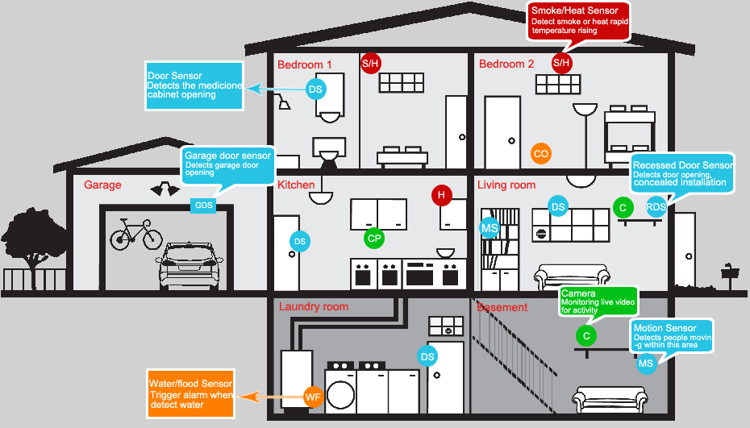
BASIC OVERVIEW OF OUR PROJECT

Slide 7
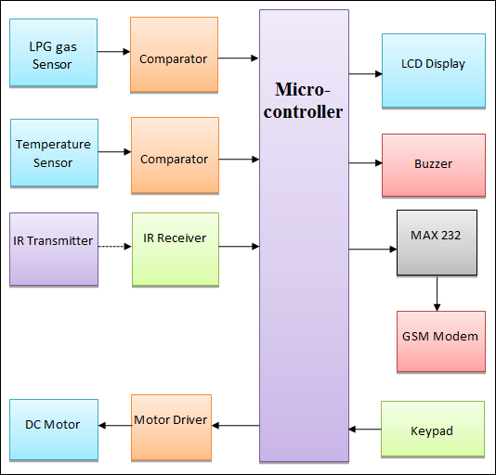
BLOCK DIAGRAMS OF OUR PROJECT

Slide 8
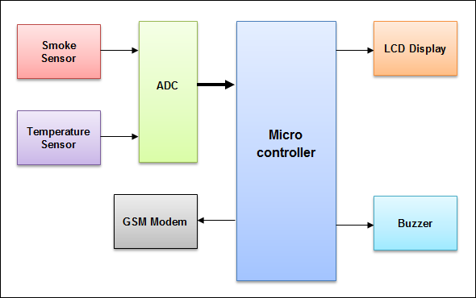
BLOCK DIAGRAMS OF OUR PROJECT

Slide 9
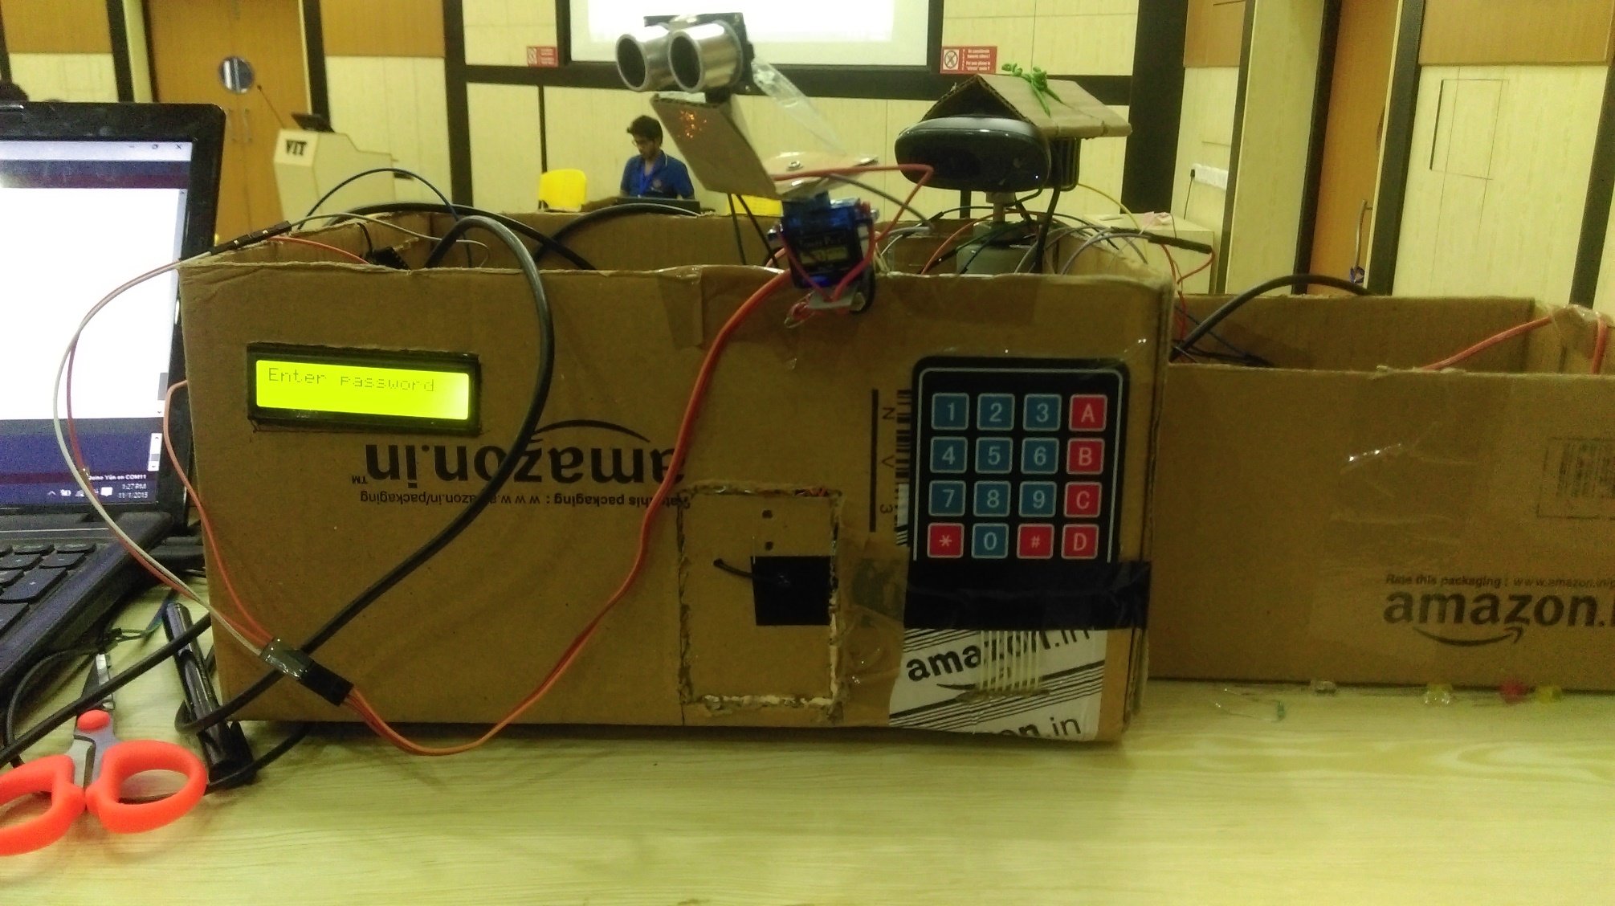
SCREENSHOTS OF OUR PROJECT

Slide 10
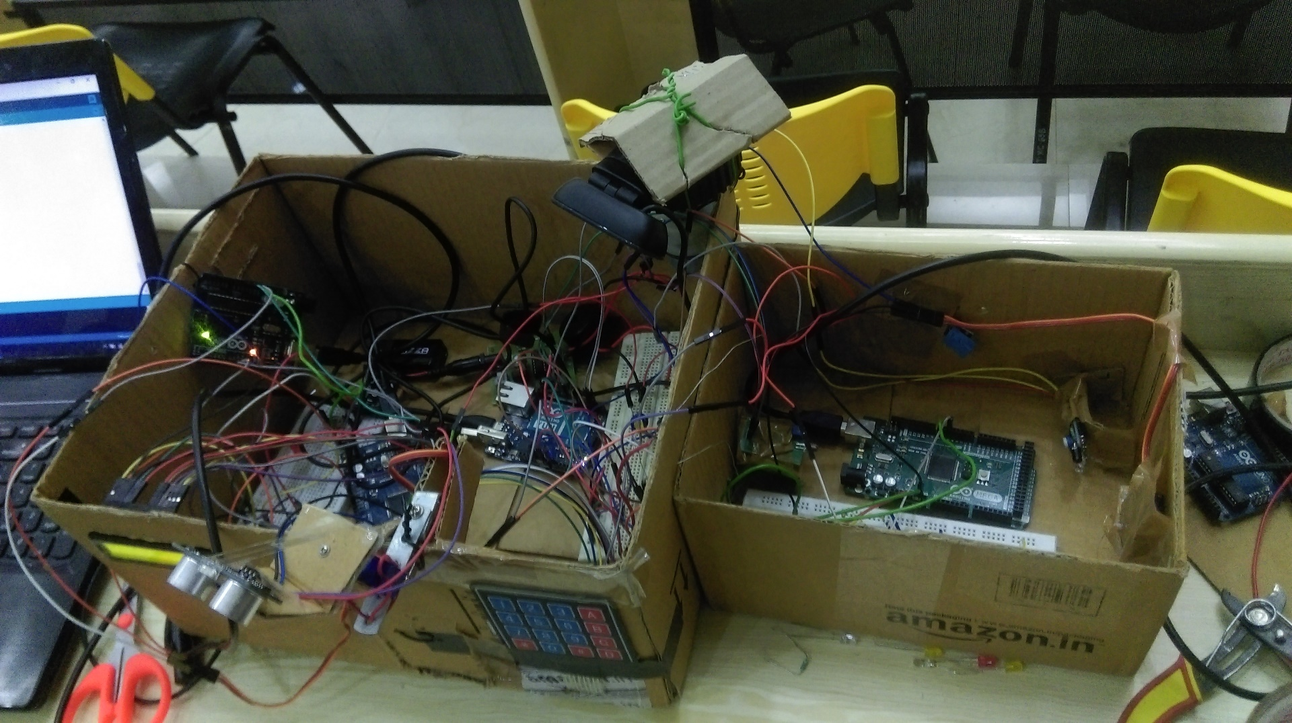
SCREENSHOTS OF OUR PROJECT

Slide 11
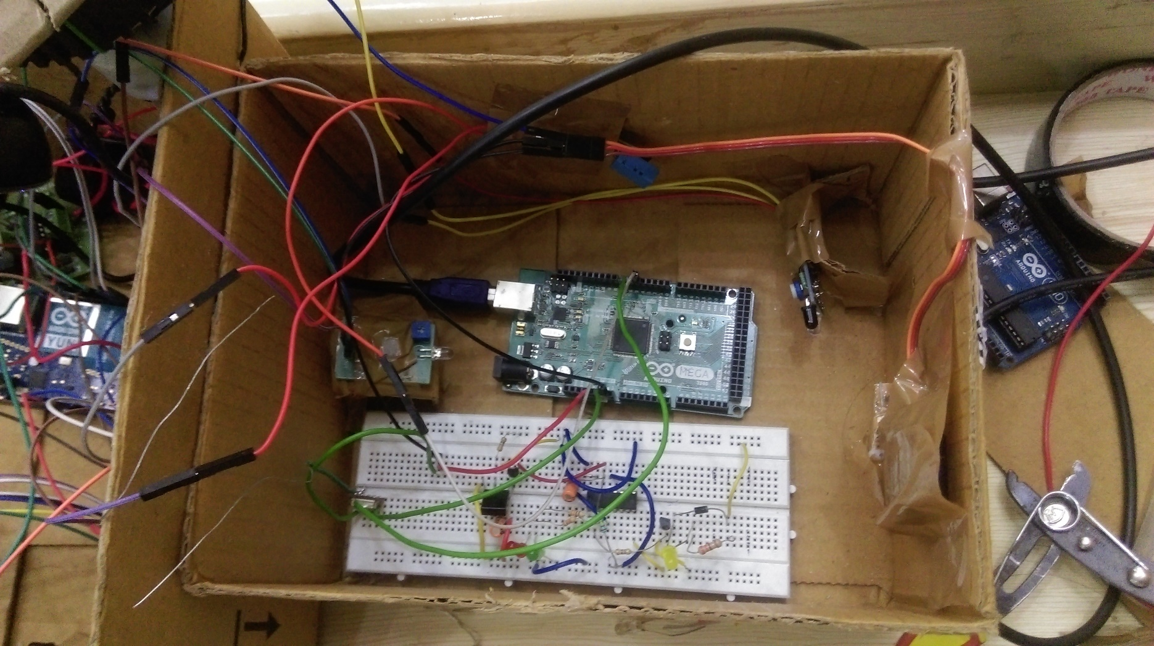
SCREENSHOTS OF OUR PROJECT

Slide 12
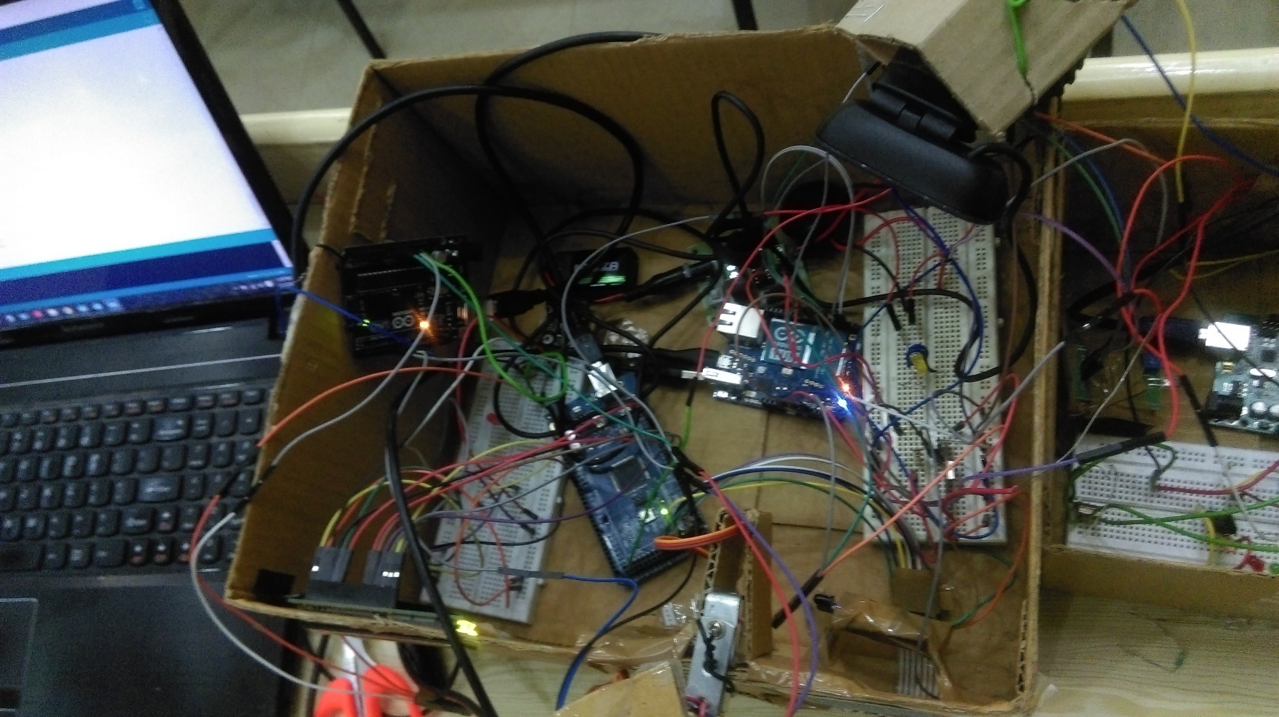
SCREENSHOTS OF OUR PROJECT

Slide 13
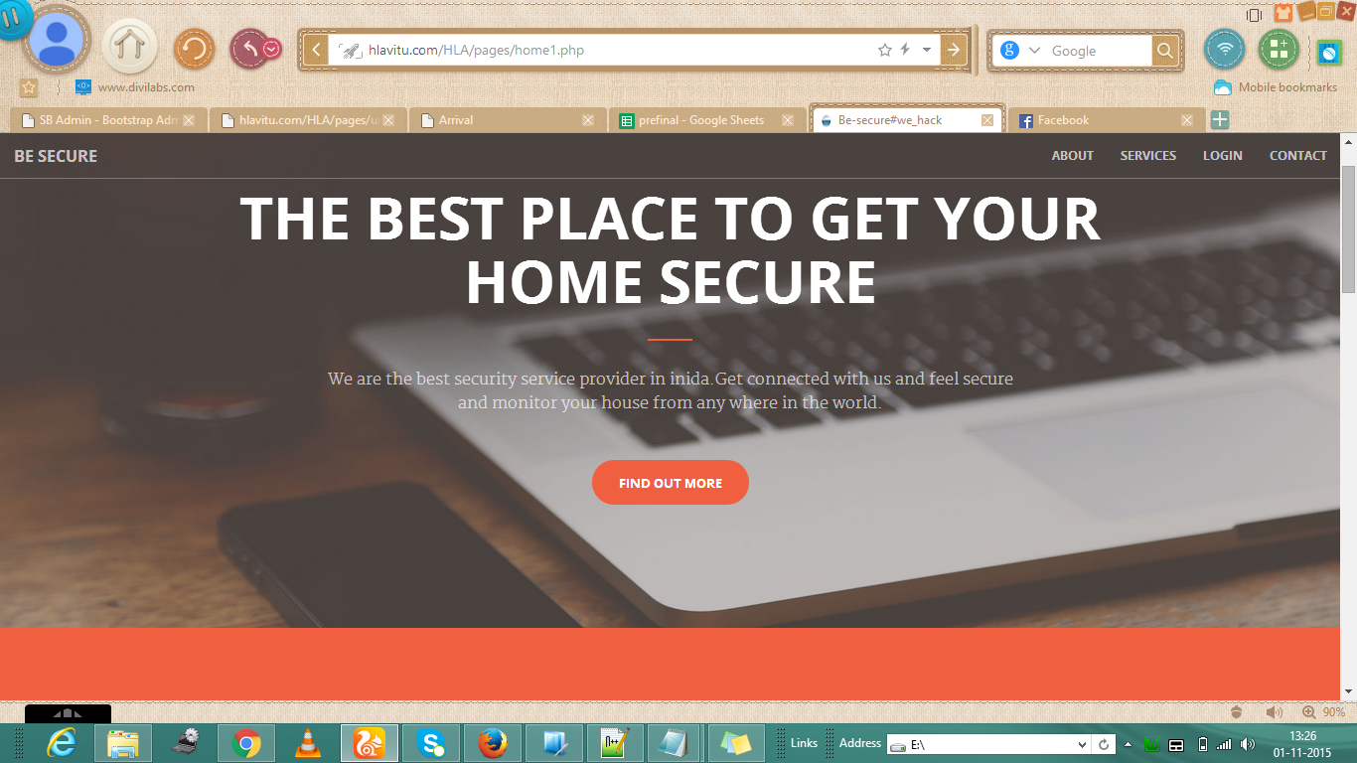
SCREENSHOTS OF OUR PROJECT

Slide 14
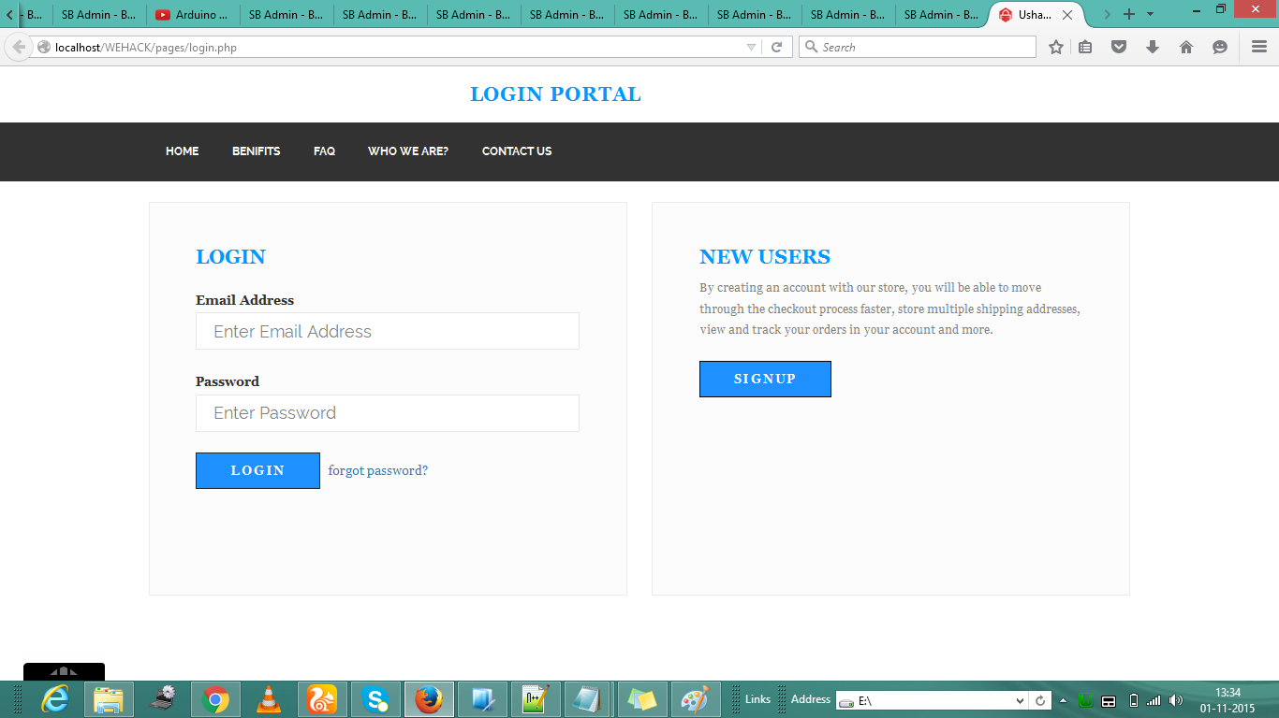
SCREENSHOTS OF OUR PROJECT

Slide 15
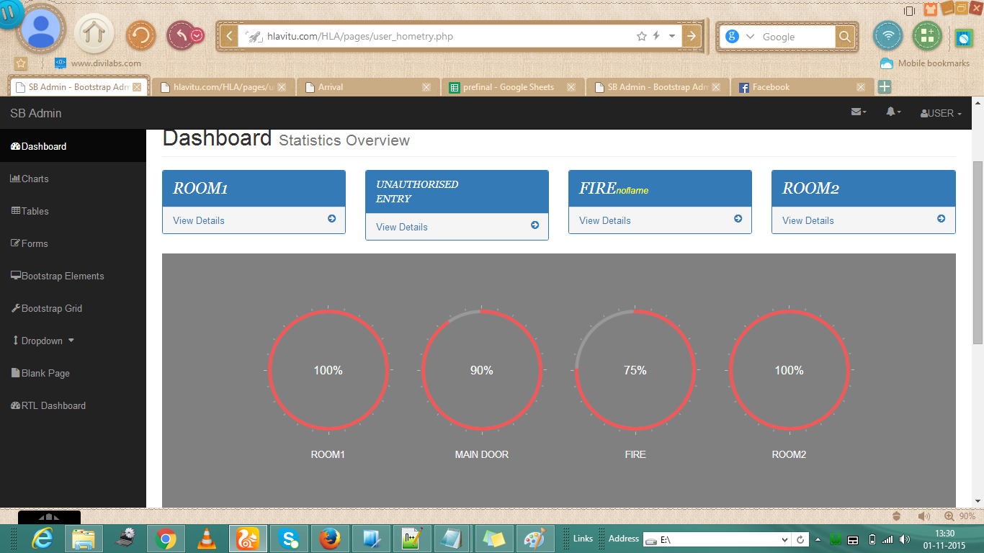
SCREENSHOTS OF OUR PROJECT

Slide 16
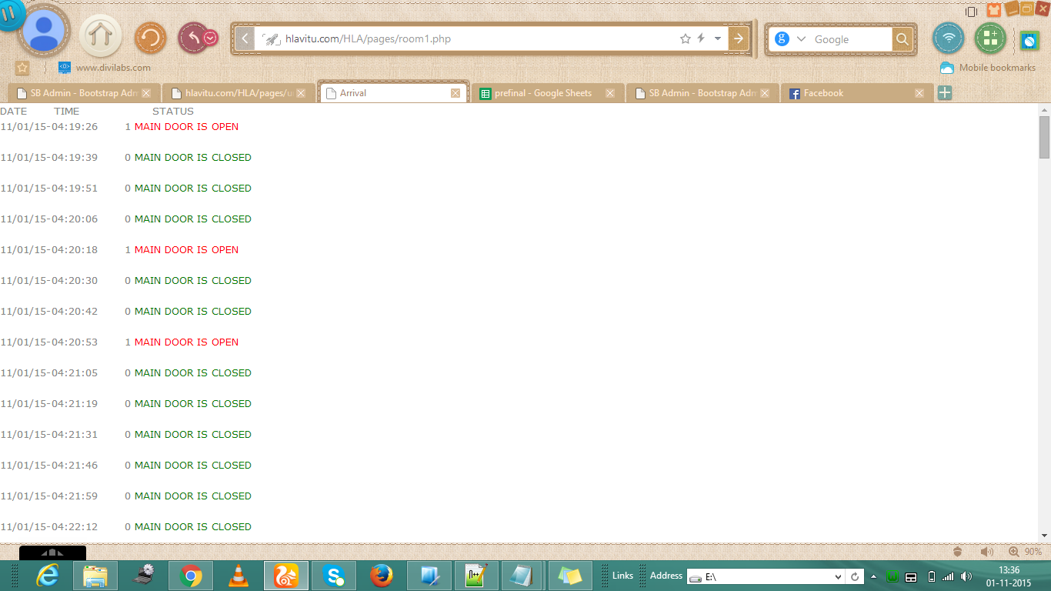
SCREENSHOTS OF OUR PROJECT

Slide 17
IMPACT
Working-Class People
Very useful for Disabled People
Also very useful for Elderly People
Helps in keeping a tab on any person who needs supervision
For people who travel a lot

Slide 18
NOVELTY
We have made a cloud-managed smart home system
Internet Of Things (IoT)
Smart technologies designed to blend in with a consumer’s décor;
Wireless on/off controls
Automated door locking systems
Advanced security and sensing systems.

Slide 19
BENEFITS
Adds Safety Through Appliance and Lighting Control
Secures Home Through Automated Door Locks
Increases Awareness Through Security Cameras
Increases Convenience Through Different Sensing Modules
Saves Time
Saves Money and Increases Convenience
Increases Peace of Mind
Allows You Control When Out of Town

Slide 20
POPULAR SMART HOMES AND BUSINESS PLANS
Many smart homes are custom-built by construction and architectural firms for wealthy clients. Firms selling smart home technologies in this space include VIA International, Vivint, Creston, Control4, Savant and AMX Home automation.
Beyond this market are less expensive smart home devices and systems, largely manufacturer by security, software and electronics firms. Rival software firms Apple and Google are two major players in this marketspace. Google recently acquired the aforementioned Nest Learning Thermostat for $3.2 billion, and has designs on the home security market. Apple is designing a software platform to control smart home devices, and is in talks with a group of retailers to incorporate it into their devices. Another large player in this market is AT&T, whose Digital Life service, consisting of one app and a wireless adapter device, aggregates all services and devices and the consumer pays a monthly fee for this service. Samsung, GE, Comcast, Time Warner, Staples, Best Buy, ADT, Tyco, and other firms are also in the mix.

Slide 21
FEASIBILITY
The truth is that this system is quite expensive and would cost a fortune for most people.
Any effort to cost optimize the whole system could make the system less effective and less efficient as well.
So for keeping the whole innovation part intact and preserving the sanctity of the project it would be costly
So majorly it is for Working-Class and people with higher standard of living.

Slide 22
FEASIBILITY
Linking disparate systems
Limited functionality
Costs
Awareness
The potential for criminals to hack into a smart home system
The overall demand for housing has a significant impact on the overall demand for smart homes, as many smart home technologies are purchased by construction companies, and integrated into new residential construction.
Flaws in the system

Slide 23
FUTURE OF SMART HOMES
Integrating more IoT in Smart Homes
Robotics in Smart Homes
The integration of health monitoring equipment could have a tremendous beneficial impact on average families, especially those in rural areas.
If manufacturers want to ensure that their devices talk to others, they will have be developed under common standards – standards also shared between software companies.

